Slide 1

Financial Risk Management
Spring 2016
Dr. Ehud Peleg
Credit Risk –
Estimating Default Probabilities

Slide 2
Credit Risk
Risk of an obligor or counterparty default, which would lead to their failure to meet contractual obligations in relation to actual, contingent or potential claims.
Examples
Loans: Mortgages, C&I, CRE
Corporate bonds, EM bonds, Muni bonds
Lines of Credit, Guarantees
Trade Credit
Counterparty Credit Risk
Credit Default Swap

Slide 3
Credit Risk Measures
Probability of Default (PD) − The likelihood that the borrower will fail to make full and timely repayment of its financial obligations
Usually measured per year
Exposure At Default (EAD) − The expected amount of the debt at the time of default
Loss Given Default (LGD) − The amount of the loss if there is a default, expressed as a percentage of the EAD
Equal to (1 − Recovery Rate)
Expected Loss (EL) = PD*LGD*EAD

Slide 4
Agenda
Credit Rating and Historical Data
Conditional vs Unconditional Default Probabilities
Rating Methods
Statistical Methods
Expert Judgment and Scorecards
Validation of Ratings
Recovery Rates
Market Based Methods
CDS and bond spreads
Structural / Merton’s model
Market Implied Signals

Slide 5
Credit Rating
We can allocate exposures into rating groups according to their perceived probability of default
External ratings – performed by rating agencies (Moody’s, S&P, Fitch)
Internal ratings – performed by the bank/lender/owner of exposure

Slide 6
Moody’s Rating Scale

Slide 7
Annual Corporate Default Rates
Moody’s Annual Default Study, 2016

Slide 8
Annual Corporate Defaults, 1920-2015
Aaa | Aa | A | Baa | Ba | B | Caa-C
Mean
Median
SD
Min
Max
^{Moody’s 2016}

Slide 9
Default Rates by Industry - 2015
^{Moody’s 2016}

Slide 10
Cumulative Average Default Rates 1983 - 2015
^{Moody’s 2016}

Slide 11
Cumulative Default Chart
The table shows the probability of default for companies starting with a particular credit rating
A company with an initial credit rating of Baa has a probability of 0.200% of defaulting by the end of the first year, 0.508% by the end of the second year, and so on
It has 2.503% chance of defaulting in 7 years, or 97.497% of not defaulting in 7 years.

Slide 12
Conditional vs. Unconditional Default Probability
The unconditional default probability is the probability of default as seen at time zero
Example: Baa in year 3: 0.854%-0.508%=0.346%
The conditional probability of default is the probability of default over a time period conditional on no earlier default
Baa in year 3: 0.346%/(100%-0.508%) = 0.348%
Year | 1 | 2 | 3 | 4 | 5 | 6 | 7
Cumulative PD | 0.200 | 0.508 | 0.854 | 1.266 | 1.679 | 2.104 | 2.503
Unconditional PD | 0.200 | 0.308 | 0.346 | 0.412 | 0.413 | 0.425 | 0.399
Conditional PD | 0.200 | 0.309 | 0.348 | 0.416 | 0.418 | 0.432 | 0.408

Slide 13
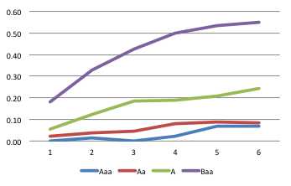
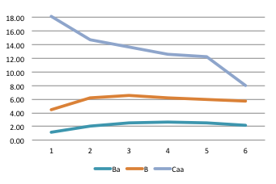
Conditional PD in One Year in the Future
For a company that starts with a good credit rating default probabilities tend to increase with time
For a company that starts with a poor credit rating default probabilities tend to decrease with time

Slide 14
Hazard rates
Hazard rate is the conditional default probability for unit of time.
Suppose that λ(t) is the hazard rate at time t
The probability of default between times t and t+Δt conditional on no earlier default is λ(t)Δt
The probability of default by time T is
where is the average hazard rate between time zero and time T. (see next slide)

Slide 15
Probability of Default by time T
V(t) – Probability of Survival till time t
Q(T) – Probability of Default by time T
The probability of survival till time t+Δt is the probability of survival till time t multiplied by the conditional probability of not defaulting over Δt:

Slide 16
One-Year Rating Transition Matrix (% probability, Moody’s 1970-2010)
Initial
Rating at year end
Rating
Aaa
Aa
A
Baa
Ba
B
Caa
Ca-C
Default
Aaa
90.42
8.92
0.62
0.01
0.03
0.00
0.00
0.00
0.00
Aa
1.02
90.12
8.38
0.38
0.05
0.02
0.01
0.00
0.02
A
0.06
2.82
90.88
5.52
0.51
0.11
0.03
0.01
0.06
Baa
0.05
0.19
4.79
89.41
4.35
0.82
0.18
0.02
0.19
Ba
0.01
0.06
0.41
6.22
83.43
7.97
0.59
0.09
1.22
B
0.01
0.04
0.14
0.38
5.32
82.19
6.45
0.74
4.73
Caa
0.00
0.02
0.02
0.16
0.53
9.41
68.43
4.67
16.76
Ca-C
0.00
0.00
0.00
0.00
0.39
2.85
10.66
43.54
42.56
Default
0.00
0.00
0.00
0.00
0.00
0.00
0.00
0.00
100.00

Slide 17
Internal Rating
Deutsche Bank Annual Report

Slide 18
Internal Rating Methods
Credit Scoring –
Statistical methods
Typically used for retail credit, credit cards and increasingly for SME
Applied in automatic fashion
Expert Judgment and Scorecards –
Combined quantitative and qualitative method
Typically used for larger firms, sovereigns and munis
Applied on a credit by credit basis

Slide 19
Qualitative Response (QR) Models
What is the probability of default in the next period, conditional on current market and firm characteristics (typically accounting ratios)?
The models take the form of:
Probit Model:
Logit Model:

Slide 20
Fitting QR Models using MLE
Suppose we observe N companies, with characteristic x_{i} and an indicator whether they defaulted, D_{i}
We can write the likelihood of one observation:
The log likelihood of observing the data:

Slide 21
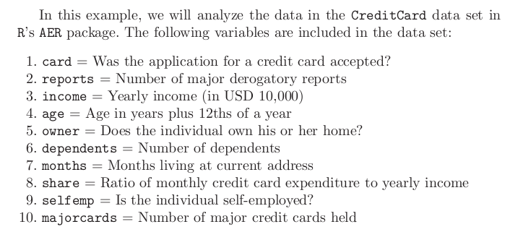
Example

Slide 22
Linear Discriminant Analysis
We suppose that firm characteristics (x) have a multivariate Normal distribution conditional on whether the firm defaults or not.
Assume they have the same covariance in both cases, but different means:
We can estimate the mean and covariance by their sample statistics.

Slide 23
Linear Discriminant Analysis (cont)
By Bayes Rule:
We estimate P(D=1) by π, the proportion of defaults in the sample. P(D=0) is 1-π.
Define log odds as:
It is a transformation of the probability of default

Slide 24
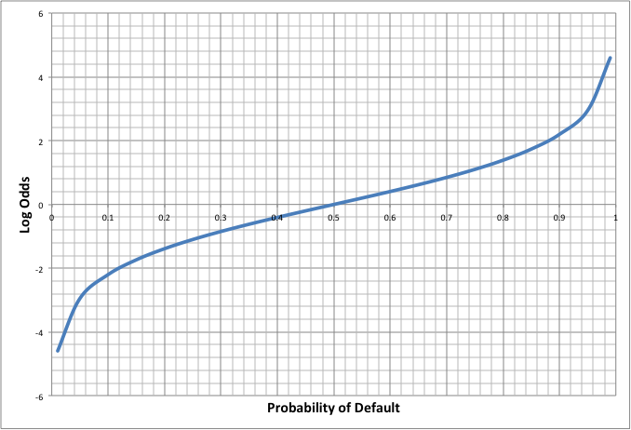
Log Odds vs Probability

Slide 25
LDA – Log Odds and Linear Rule
This is a linear combination of the x’s:

Slide 26
LDA – Multiple Ratings

Slide 27
Altman’s Z-score (Manufacturing companies)
X₁=Working Capital/Total Assets
X₂=Retained Earnings/Total Assets
X₃=EBIT/Total Assets
X₄=Market Value of Equity/Book Value of Liabilities
X₅=Sales/Total Assets

Slide 28
What do the ratios mean?
X1 measures liquidity
X2 is indicative of cumulative profitability, but also age of firm and leverage
X3 is a measure of underlying profitability
X4 measures how much assets can drop in market value before they don’t cover liabilities
X5 Firm’s ability to compete and generate revenues

Slide 29
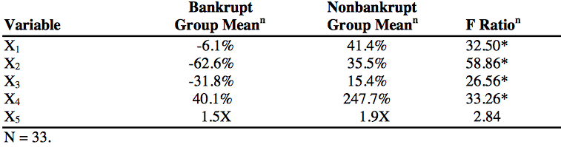
Conditional Means in Altman’s Population
To estimate the LDA we use the conditional means of the characteristics conditional on bankruptcy.
There is a significant difference between the means of the variables conditional on whether there was default.

Slide 30
Altman’s Z-score (Manufacturing companies)
Z = 1.2X₁+1.4X₂+3.3X₃+0.6X₄+1.0X₅
Z > 3.0: default is unlikely;
2.7 < Z < 3.0: we should be on alert;
1.8 < Z < 2.7: moderate chance of default;
Z < 1.8: high chance of default

Slide 31
Log Odds and Logit
The log odds is linear in x for the LDA.
It is also the case for Logit:
The two models are not the same since LDA has a restriction on the conditional distribution of x_{i} given D_{i}.

Slide 32
Model Estimation
Probit and Logit models can be estimated in R using glm:
glm(formula = card~income, family = binomial (link="probit"), data=CreditCard)
Likelihood estimation techniques (Fisher Information and LR tests) can be used to select variables and assess goodness of fit.
LDA implies computing sample averages and covariance matrix

Slide 33
Scorecards
Rating agencies and commercial lenders typically use scorecards that incorporate expert judgment with quantitative models
The scorecards are particular to certain industries, types of projects, or company size
The results are interpreted as ratings which are then calibrated to PD

Slide 35
Quantitative Categories

Slide 36
Qualitative Categories

Slide 37
Validation of PD Models
Assessment of Discriminatory Power – The ability of the rating system to differentiate between borrowers who will default and those who won’t
“Does a better rating imply lower chance of default?”
Calibration – Is the difference between estimated PD and observed default rates acceptable
Similar to backtesting in market risk,
But, with less observations to test since:
Annual instead of daily
High grade borrowers rarely default

Slide 38
Confusion Matrix
Model Prediction
 | Good - Lend | Bad - Turn Away
Good | True Positive | False Negative
Bad | False Positive | True Negative
Actual Outcome
True Positive Rate = TP/(TP+FN): How many of “actual goods” did we lend to?
False Positive Rate = FP/(FP+TN): How many of “actual bads” did we lend to?
As we lower the threshold score and loosen our underwriting, both rates go up.

Slide 39
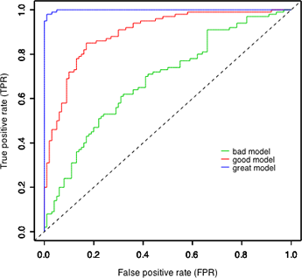
Receiver Operating Characteristic (ROC) Curve
Low Threshold
Population Default Rate
High Threshold
Zero Default Rate

Slide 40
ROC Example
Issuer | Rating | Default | Lend ALL | Lend Above CCC | Lend Above B | Lend Above BB
XYZ | CCC | 1 | FP | TN | TN | TN
ABC | CCC | 1 | FP | TN | TN | TN
… | CCC | 0 | TP | FN | FN | FN
 | B | 1 | FP | FP | TN | TN
 | B | 0 | TP | TP | FN | FN
 | B | 1 | FP | FP | TN | TN
 | B | 0 | TP | TP | FN | FN
 | BB | 1 | FP | FP | FP | TN
 | BB | 0 | TP | TP | TP | FN
 | BB | 0 | TP | TP | TP | FN
TPR |  |  | 1 | 0.8 | 0.4 | 0
FPR |  |  | 1 | 0.6 | 0.2 | 0

Slide 41
Threshold Determination
Suppose that the life time value of a customer is LTV, the credit line is D, and we are able to recover R percent from a defaulted account.
The expected profit for a given threshold is:
Profit = TP*LTV – FP*D*(1-R)
We maximize profit where the slope of the ROC is:
D*(1-R)/LTV

Slide 42
Cumulative Accuracy Profile (CAP)
Rank by Model score
Measuring the performance of corporate bond ratings – Moody’s 2003

Slide 43
CAP Example
SORT BY
Issuer | Rating | Default | Cum Share of Issuers | Cum Share of Defaults
XYZ | CCC | 1 | 10% | 20%
ABC | CCC | 1 | 20% | 40%
… | CCC | 0 | 30% | 40%
 | B | 1 | 40% | 60%
 | B | 0 | 50% | 60%
 | B | 1 | 60% | 80%
 | B | 0 | 70% | 80%
 | BB | 1 | 80% | 100%
 | BB | 0 | 90% | 100%
 | BB | 0 | 100% | 100%
#Issuers=10
#Defaults=5

Slide 44
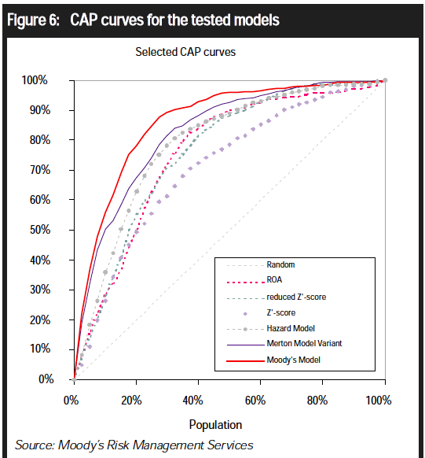

Slide 45
Accuracy Ratio
Measuring the performance of corporate bond ratings – Moody’s 2003

Slide 46
Recovery Rate
Recovery Rate for a defaulted exposure:
The present discounted value at the default date of recoveries received net of costs associated with collecting on the exposure divided by the amount of the exposure at default.
For marketable debts, we can take the traded price 30-days after default as a percentage of face value
Loss Given Default (LGD) = 1 – Recovery Rate

Slide 47
Recovery Rates Vary by Seniority and Type of Debt
Class | Ave Rec Rate (%)
First lien bank loan | 66.6
Second lien bank loan | 31.8
Senior unsecured bank loan | 47.1
1st lien bond | 53.4
2nd lien bond | 49.7
Senior unsecured bond | 37.6
Senior subordinated bond | 31.1
Subordinated bond | 31.9
Junior subordinated bond | 24.2
Moody’s: 1983 to 2015, Issuer weighted

Slide 48
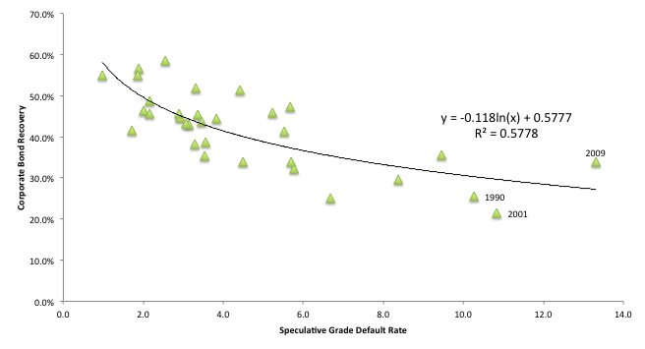
Recovery Rates Are Negatively Correlated with Default Rates
Moody’s Annual Default Study: Corporate Default and Recovery Rates, 1920-2013

Slide 49
Thanks

